Slide 1

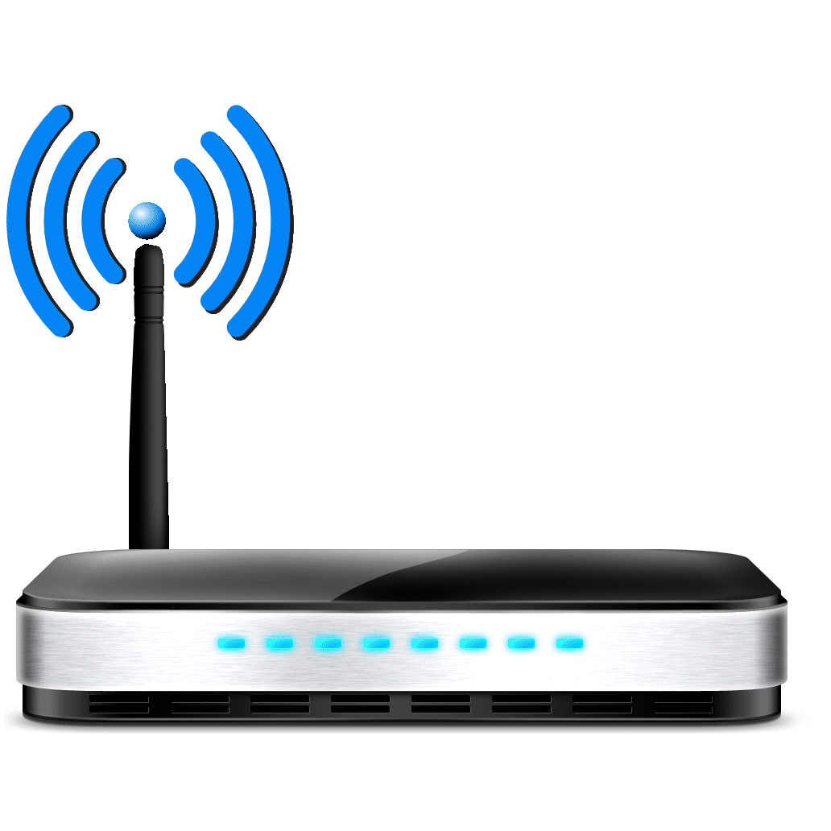
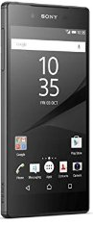

SLAM
DS
VMM
Physical Machine
Client
AC/AS

Slide 2
SLAM
1. DS is up
DS
VMM
Physical Machine
Client
AC/AS

Slide 3
SLAM
2. SLAM is up
1. DS is up
DS
VMM
Physical Machine
Client
AC/AS

Slide 4
SLAM
2. SLAM is up
3. SLAM registers
1. DS is up
DS
VMM
Physical Machine
Client
AC/AS

Slide 5
SLAM
2. SLAM is up
3. SLAM registers
1. DS is up
4. VMM is up
DS
VMM
Physical Machine
Client
AC/AS

Slide 6
SLAM
2. SLAM is up
3. SLAM registers
1. DS is up
4. VMM is up
DS
5. VMM registers
VMM
Physical Machine
Client
AC/AS

Slide 7
SLAM
2. SLAM is up
3. SLAM registers
1. DS is up
6. VMM registers
4. VMM is up
DS
5. VMM registers
VMM
Physical Machine
Client
AC/AS

Slide 8

SLAM
2. SLAM is up
3. SLAM registers
1. DS is up
6. VMM registers
4. VMM is up
DS
5. VMM registers
VMM
7. Start VM Helpers
Physical Machine
Client
AC/AS

Slide 9
SLAM
DS
VMM
Physical Machine
Physical Machine
Client
AC/AS

Slide 10
SLAM
DS
VMM
Physical Machine
Physical Machine
1. Registration
Client
AC/AS

Slide 11
SLAM
2. Find available machines
DS
VMM
Physical Machine
Physical Machine
1. Registration
Client
AC/AS

Slide 12
SLAM
2. Find available machines
DS
VMM
Physical Machine
Physical Machine
1. Registration
3. OK <VMM IP list>
Client
AC/AS

Slide 13
SLAM
2. Find available machines
DS
VMM
Physical Machine
Physical Machine
4. Registration
1. Registration
3. OK <VMM IP list>
Client
AC/AS

Slide 14
SLAM
2. Find available machines
DS
5. New VM request
VMM
Physical Machine
Physical Machine
4. Registration
1. Registration
3. OK <VMM IP list>
Client
AC/AS

Slide 15
SLAM
2. Find available machines
DS
5. New VM request
6. Start VM
VMM
Physical Machine
Physical Machine
4. Registration
1. Registration
3. OK <VMM IP list>
Client
AC/AS

Slide 16
SLAM
2. Find available machines
DS
5. New VM request
6. Start VM
VMM
Physical Machine
Physical Machine
4. Registration
1. Registration
3. OK <VMM IP list>
7. Start AS
8. Register with VMM
Client
AC/AS

Slide 17
SLAM
2. Find available machines
DS
5. New VM request
6. Start VM
9. Registration
VMM
Physical Machine
Physical Machine
4. Registration
1. Registration
3. OK <VMM IP list>
7. Start AS
8. Register with VMM
Client
AC/AS

Slide 18
SLAM
2. Find available machines
DS
5. New VM request
6. Start VM
10. OK <VM IP>
9. Registration
VMM
Physical Machine
Physical Machine
4. Registration
1. Registration
3. OK <VMM IP list>
7. Start AS
8. Register with VMM
Client
AC/AS

Slide 19
SLAM
2. Find available machines
DS
5. New VM request
6. Start VM
10. OK <VM IP>
9. Registration
VMM
Physical Machine
Physical Machine
4. Registration
1. Registration
11. OK <VM IP>
3. OK <VMM IP list>
7. Start AS
8. Register with VMM
Client
AC/AS

Slide 20
SLAM
2. Find available machines
DS
5. New VM request
6. Start VM
10. OK <VM IP>
9. Registration
VMM
Physical Machine
Physical Machine
4. Registration
1. Registration
11. OK <VM IP>
3. OK <VMM IP list>
7. Start AS
8. Register with VMM
12. UD-VM registration phase
Client
AC/AS

Slide 21
SLAM
2. Find available machines
DS
5. New VM request
6. Start VM
10. OK <VM IP>
9. Registration
VMM
Physical Machine
Physical Machine
4. Registration
1. Registration
11. OK <VM IP>
3. OK <VMM IP list>
7. Start AS
8. Register with VMM
12. UD-VM registration phase
13. Connection
Client
AC/AS

Slide 22
SLAM
2. Find available machines
DS
5. New VM request
6. Start VM
10. OK <VM IP>
9. Registration
VMM
Physical Machine
Physical Machine
4. Registration
1. Registration
11. OK <VM IP>
3. OK <VMM IP list>
7. Start AS
8. Register with VMM
12. UD-VM registration phase
13. Connection
14. APK registration on the VM
Client
AC/AS

Slide 23
SLAM
2. Find available machines
DS
5. New VM request
6. Start VM
10. OK <VM IP>
9. Registration
VMM
Physical Machine
Physical Machine
4. Registration
1. Registration
11. OK <VM IP>
3. OK <VMM IP list>
7. Start AS
8. Register with VMM
12. UD-VM registration phase
13. Connection
14. APK registration on the VM
15. RTT measurement
Client
AC/AS

Slide 24
SLAM
2. Find available machines
DS
5. New VM request
6. Start VM
10. OK <VM IP>
9. Registration
VMM
Physical Machine
Physical Machine
4. Registration
1. Registration
11. OK <VM IP>
3. OK <VMM IP list>
7. Start AS
8. Register with VMM
12. UD-VM registration phase
13. Connection
14. APK registration on the VM
15. RTT measurement
Client
16. Download rate measurement
AC/AS

Slide 25
SLAM
2. Find available machines
DS
5. New VM request
6. Start VM
10. OK <VM IP>
9. Registration
VMM
Physical Machine
Physical Machine
4. Registration
1. Registration
11. OK <VM IP>
3. OK <VMM IP list>
7. Start AS
8. Register with VMM
12. UD-VM registration phase
13. Connection
14. APK registration on the VM
15. RTT measurement
Client
16. Download rate measurement
17. Upload rate measurement

Slide 26
SLAM
2. Find available machines
DS
5. New VM request
6. Start VM
10. OK <VM IP>
9. Registration
VMM
Physical Machine
Physical Machine
4. Registration
1. Registration
11. OK <VM IP>
3. OK <VMM IP list>
7. Start AS
8. Register with VMM
12. UD-VM registration phase
13. Connection
14. APK registration on the VM
15. RTT measurement
Client
16. Download rate measurement
17. Upload rate measurement
18. Registration completed!

Slide 27
SLAM
2. Find previous machine
6. Find previous
VM
DS
5. Prev VM request
7. OK <VM IP>
VMM
Physical Machine
Physical Machine
4. Registration
1. Prev VM request
8. OK <VM IP>
3. OK <VMM IP>
9. UD-VM registration phase
10. Connection
11. APK registration on the VM
12. RTT measurement
13. Download rate measurement
14. Upload rate measurement
Client
15. Registration completed!
AC/AS

Slide 28
SLAM
2. Find previous machine
6. Find previous
VM
DS
5. Prev VM request
7. OK <VM IP>
VMM
Physical Machine
Physical Machine
4. Registration
1. Prev VM request
8. OK <VM IP>
3. OK <VMM IP>
9. UD-VM registration phase
10. Connection
11. APK registration on the VM
12. RTT measurement
13. Download rate measurement
14. Upload rate measurement
Client
AC/AS

Slide 29
SLAM
2. Find previous machine
6. Find previous
VM
DS
5. Prev VM request
7. OK <VM IP>
VMM
Physical Machine
Physical Machine
4. Registration
1. Prev VM request
8. OK <VM IP>
3. OK <VMM IP>
9. UD-VM registration phase
10. Connection
11. APK registration on the VM
12. RTT measurement
13. Download rate measurement
Client
AC/AS

Slide 30
SLAM
2. Find previous machine
6. Find previous
VM
DS
5. Prev VM request
7. OK <VM IP>
VMM
Physical Machine
Physical Machine
4. Registration
1. Prev VM request
8. OK <VM IP>
3. OK <VMM IP>
9. UD-VM registration phase
10. Connection
11. APK registration on the VM
12. RTT measurement
Client
AC/AS

Slide 31
SLAM
2. Find previous machine
6. Find previous
VM
DS
5. Prev VM request
7. OK <VM IP>
VMM
Physical Machine
Physical Machine
4. Registration
1. Prev VM request
8. OK <VM IP>
3. OK <VMM IP>
9. UD-VM registration phase
10. Connection
11. APK registration on the VM
Client
AC/AS

Slide 32
SLAM
2. Find previous machine
6. Find previous
VM
DS
5. Prev VM request
7. OK <VM IP>
VMM
Physical Machine
Physical Machine
4. Registration
1. Prev VM request
8. OK <VM IP>
3. OK <VMM IP>
9. UD-VM registration phase
10. Connection
Client
AC/AS

Slide 33
SLAM
2. Find previous machine
6. Find previous
VM
DS
5. Prev VM request
7. OK <VM IP>
VMM
Physical Machine
Physical Machine
4. Registration
1. Prev VM request
8. OK <VM IP>
3. OK <VMM IP>
9. UD-VM registration phase
Client
AC/AS

Slide 34
SLAM
2. Find previous machine
6. Find previous
VM
DS
5. Prev VM request
7. OK <VM IP>
VMM
Physical Machine
Physical Machine
4. Registration
1. Prev VM request
8. OK <VM IP>
3. OK <VMM IP>
Client
AC/AS

Slide 35
SLAM
2. Find previous machine
6. Find previous
VM
DS
5. Prev VM request
7. OK <VM IP>
VMM
Physical Machine
Physical Machine
4. Registration
1. Prev VM request
3. OK <VMM IP>
Client
AC/AS

Slide 36
SLAM
2. Find previous machine
6. Find previous
VM
DS
5. Prev VM request
VMM
Physical Machine
Physical Machine
4. Registration
1. Prev VM request
3. OK <VMM IP>
Client
AC/AS

Slide 37
SLAM
2. Find previous machine
DS
5. Prev VM request
VMM
Physical Machine
Physical Machine
4. Registration
1. Prev VM request
3. OK <VMM IP>
Client
AC/AS

Slide 38
SLAM
2. Find previous machine
DS
VMM
Physical Machine
Physical Machine
4. Registration
1. Prev VM request
3. OK <VMM IP>
Client
AC/AS

Slide 39
SLAM
2. Find previous machine
DS
VMM
Physical Machine
Physical Machine
1. Prev VM request
3. OK <VMM IP>
Client
AC/AS

Slide 40
SLAM
2. Find previous machine
DS
VMM
Physical Machine
Physical Machine
1. Prev VM request
Client
AC/AS

Slide 41
SLAM
DS
VMM
Physical Machine
Physical Machine
1. Prev VM request
Client
AC/AS

Slide 42
SLAM
DS
VMM
Physical Machine
Physical Machine
Client
AC/AS

Slide 43

SLAM
DS
VMM
Physical Machine
Physical Machine
1. Prepare data
2. Run method on the device
Client
3. Finished!
AC/AS

Slide 44
SLAM
DS
VMM
Physical Machine
Physical Machine
1. Prepare data
2. Run method on the device
Client
AC/AS

Slide 45
SLAM
DS
VMM
Physical Machine
Physical Machine
1. Prepare data
Client
AC/AS

Slide 46
SLAM
DS
VMM
Physical Machine
Physical Machine
Client
AC/AS

Slide 47
SLAM
DS
VMM
Physical Machine
Physical Machine
4. Remote result
3. Run method on the VM
1. Prepare data
2. Offload <method> <data>
Client
5. Finished!
AC/AS

Slide 48
SLAM
DS
VMM
Physical Machine
Physical Machine
4. Remote result
3. Run method on the VM
1. Prepare data
2. Offload <method> <data>
Client
AC/AS

Slide 49
SLAM
DS
VMM
Physical Machine
Physical Machine
3. Run method on the VM
1. Prepare data
2. Offload <method> <data>
Client
AC/AS

Slide 50
SLAM
DS
VMM
Physical Machine
Physical Machine
1. Prepare data
2. Offload <method> <data>
Client
AC/AS

Slide 51
SLAM
DS
VMM
Physical Machine
Physical Machine
1. Prepare data
Client
AC/AS

Slide 52
SLAM
DS
VMM
Physical Machine
Physical Machine
Client
AC/AS

Slide 53
SLAM
6. Run method on VM Helper
7. Send partial result to VM
DS
4. <VM Helper IP>
VMM
3. Parallel REQ <1 VM>
Physical Machine
Physical Machine
8. Remote result
1. Prepare data
5. Send method to VM Helper
6. Run method on VM
7. Combine partial results
2. Offload <method> <data> <2 VMs>
Client
9. Finished!
AC/AS

Slide 54
SLAM
DS
VMM
Physical Machine
Physical Machine
4. Remote result
1. Prepare data
2. Offload <CUDA method> <data>
3. Run CUDA method
Client
5. Finished!
AC/AS

Slide 55
SLAM
Run method on VM
Run CUDA methods on VM with GPU
DS
VMM
Physical Machine
Physical Machine
6. Remote result
1. Prepare data
2. Offload <method> <data>
5. Run CUDA method
Client
7. Finished!
AC/AS

Slide 56
SLAM
DS
VMM
Physical Machine
Physical Machine
3. Run method
1. Prepare data
2. Offload <method> <data>
2. Offload <method> <data>
4. Result
4. Result
Client
5. Finished!
AC/AS

Slide 57
SLAM
DS
VMM
Physical Machine
Physical Machine
3. Run method
1. Prepare data
2. Offload <method> <data>
2. Offload <method> <data>
4. Result
4. Result
Client
AC/AS

Slide 58
SLAM
DS
VMM
Physical Machine
Physical Machine
3. Run method
1. Prepare data
2. Offload <method> <data>
2. Offload <method> <data>
Client
AC/AS

Slide 59
SLAM
DS
VMM
Physical Machine
Physical Machine
1. Prepare data
2. Offload <method> <data>
2. Offload <method> <data>
Client
AC/AS

Slide 60
SLAM
DS
VMM
Physical Machine
Physical Machine
1. Prepare data
Client
AC/AS

Slide 61
SLAM
DS
VMM
Physical Machine
Physical Machine
Client
AC/AS

Slide 62
SLAM
DS
VMM
Physical Machine
Physical Machine
Listening for D2D devices…
Broadcasting…
Client
Received!
AC/AS

Slide 63
SLAM
DS
VMM
Physical Machine
Physical Machine
Listening for D2D devices…
Broadcasting…
Client
AC/AS

Slide 64
SLAM
DS
VMM
Physical Machine
Physical Machine
Listening for D2D devices…
Client
AC/AS

Slide 65
SLAM
DS
VMM
Physical Machine
Physical Machine
Client
AC/AS

